Slide 1

Amazon Product Review Analysis
Done by: Md Abdul Qadir Khan Soofi
Prakash.j.m

Slide 2
Agenda
To analyze:-
The reasons for negative reviews from the customers side in office supplies and Toys & games datasets.
The reasons for customer attrition.
Sales for coming three years(assuming the current year as 2018).
The sales for top 10 and bottom 10 brands for coming 3 years.

Slide 3
Analysis is based on:-
Brands having negative responses
Trend in negative response over years
Classification of responses based on verified and non verified ids
Ids giving negative responses from non verified accounts
Sales response over years
Brands having high sales as well as positive response

Slide 4
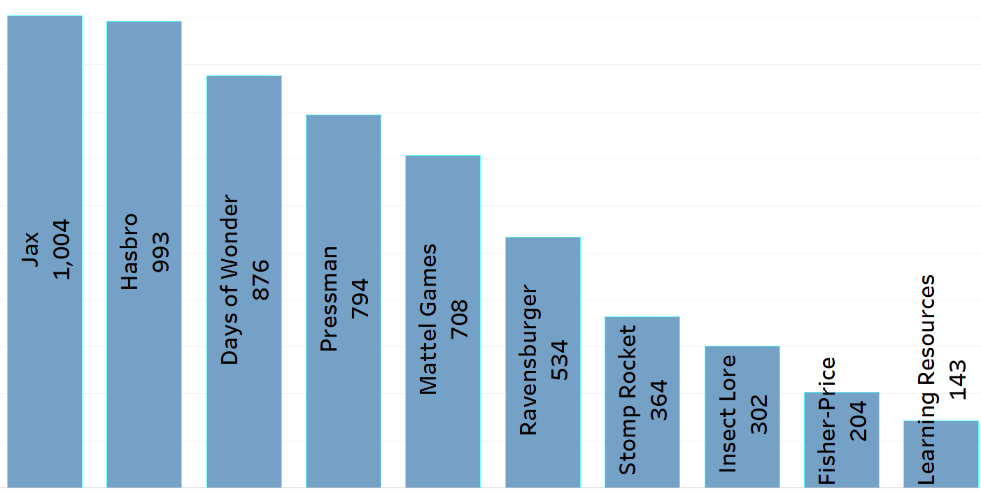
Brands having negative responses (Toys & games)
OBSERVATION :
Among Top 10 Negative responses jax is recorded with 1,004 of negative responses and second next to it is Hasbro Brand with the count of 993 negative responses
SOLUTION :
These brands should be given strict guidelines related to quality and their sale should be followed if they still fail to deliver the quality product.

Slide 5
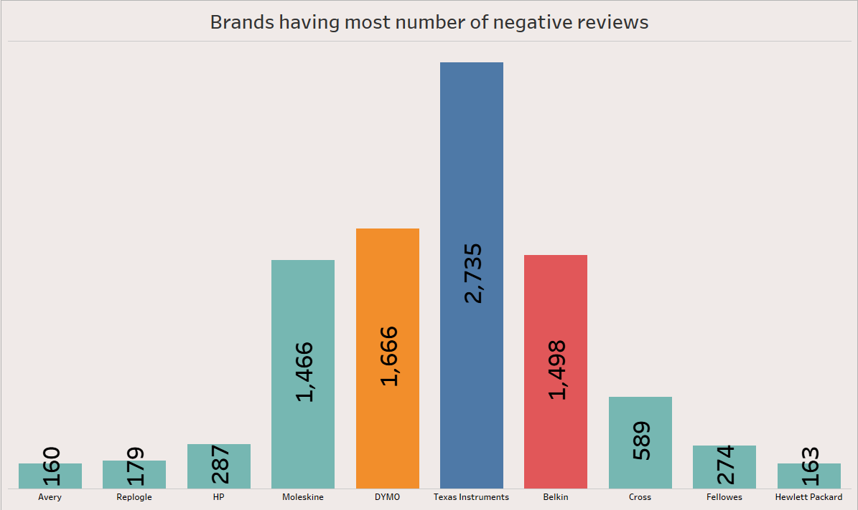
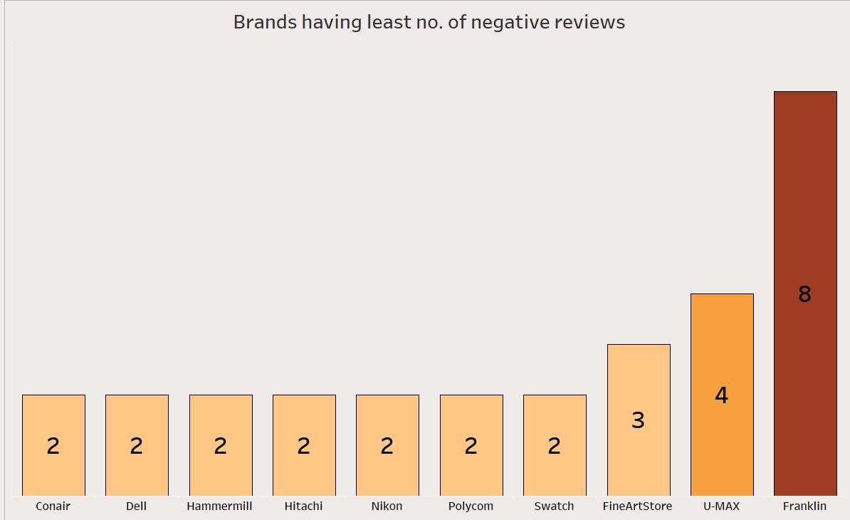
Ranking of Brands based on Negative Feedbacks (Office Supplies)
Texas Instruments, DYMO, Belkin got the most negative reviews.
The reason for this needs to be known and the retailers or the manufacturer should be advised to take necessary steps to avoid attrition.
Conair, Dell are the brands with the least negative reviews.
The suppliers of these brand products should be provided with more benefits to further motivate and these brands should be advertised more to avoid attrition.

Slide 6
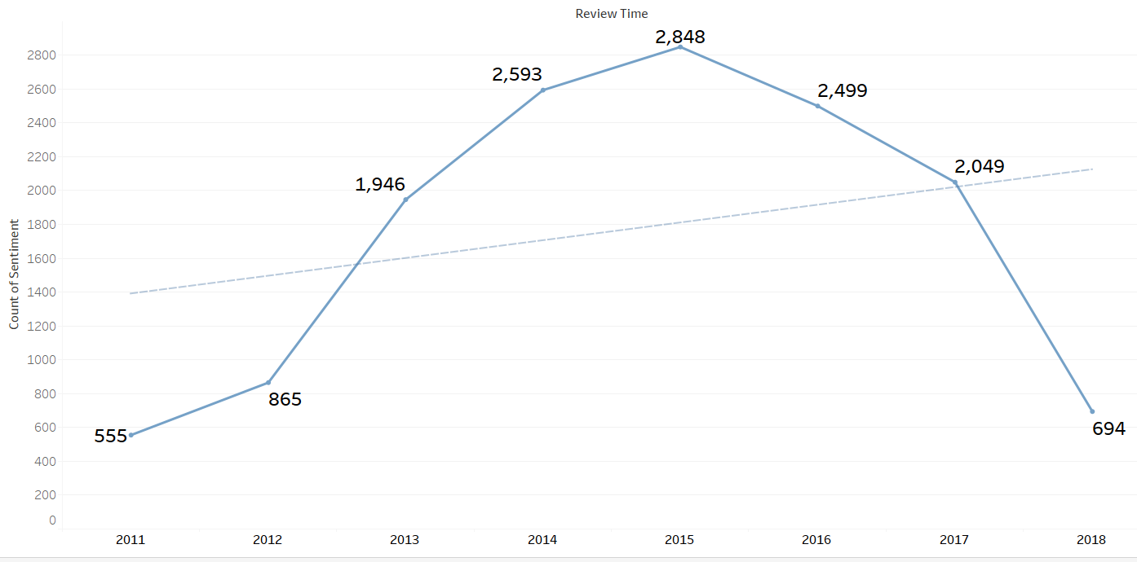
Trend in negative response over years (Toys & Games)
OBSERVATION :
Among last 10 years there is a hike of negative responses after 2013 and highest recorded is in 2015 and there is a dip after 2016
SOLUTION :
we should acknowledge the problem and rectify it from the negative responses this way we can reduce those responses

Slide 7
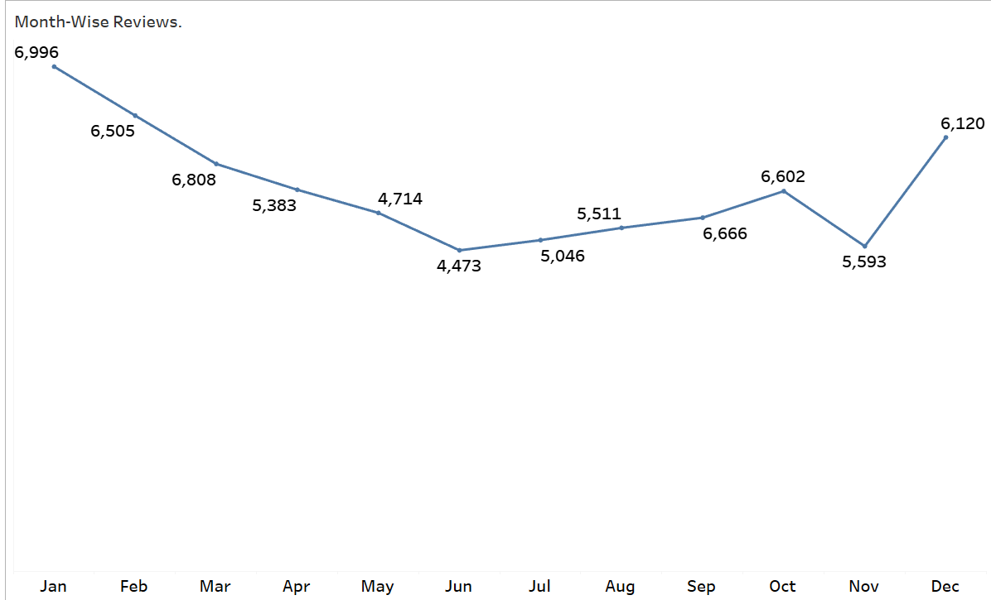
Month-Wise Negative Reviews (Office Supplies)
January and December has the highest no. of negative reviews.
The possible reason for this could be the annual sales(Christmas and New Year sales) which happen in these months.
Due to the sale there is huge pressure on all the employees including packing and delivery executives so to overcome this we can hire people on contract basis during the sales so that the manpower could increase and also customers complaints regarding these issues can be reduced.

Slide 8
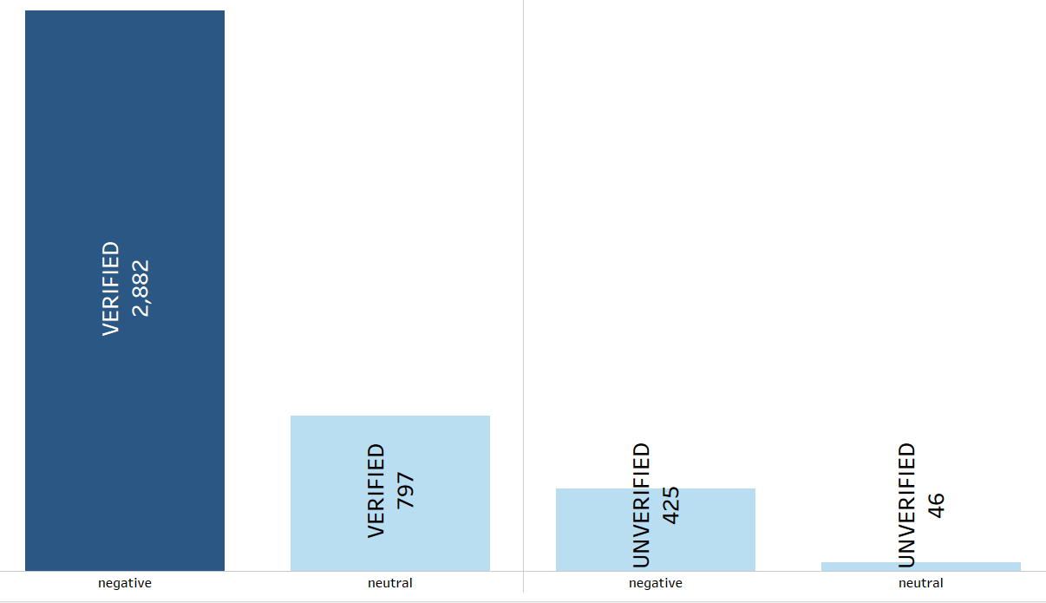
Classification of Responses from verified and non verified Id’s
SOLUTION :
We should filter the customers from non-verified id’s
and find the actual product buyers and fake responses
giving id’s
OBSERVATION :
From the observations we get there are Around 620 non verified id's has given negative and neutral responses

Slide 9
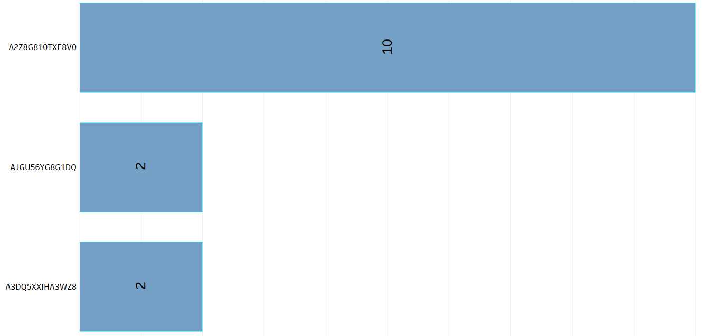
Ids giving negative responses from non verified accounts(Toys and Games)
OBSERVATION :
Among all negative responses from the no verified id’s
A2Z8GB10TXE8V0 has given more number of negative
responses
SOLUTION :
We should verify that the reviews are geniune if not
block those id’s,who have might given false responses

Slide 10
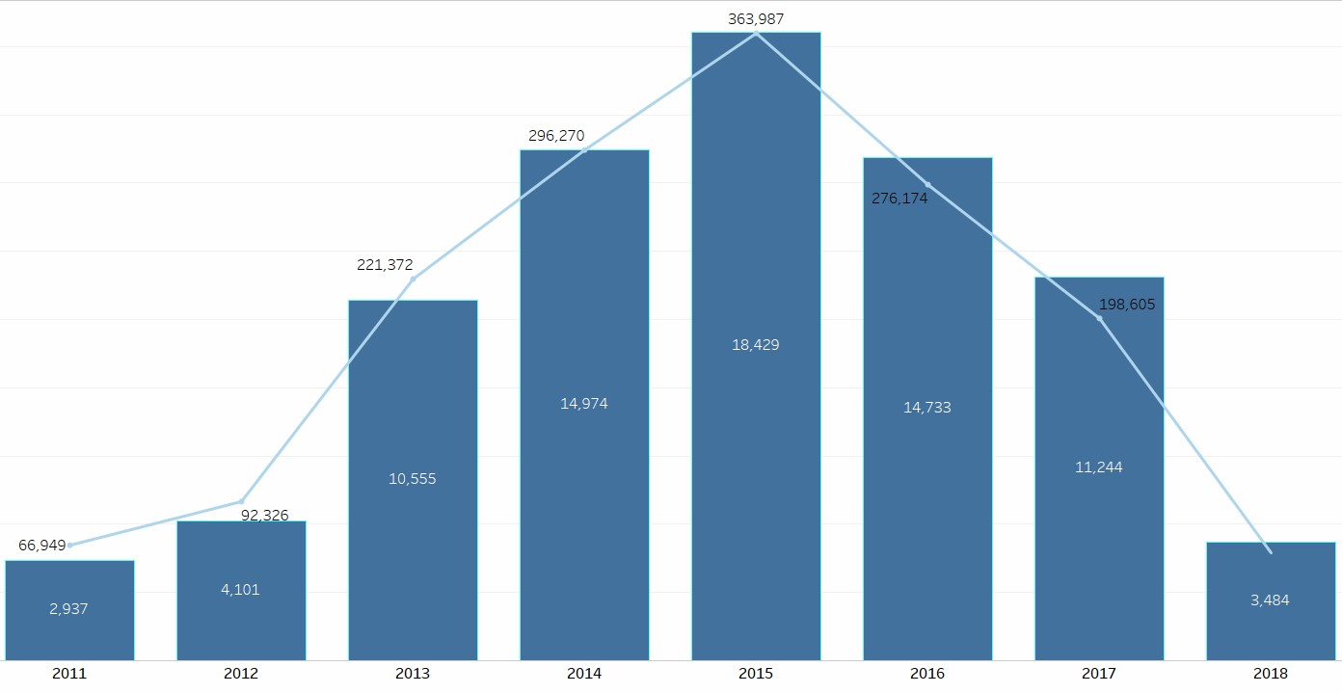
Sales response over years (Toys & Games)
OBSERVATION :
There is sales dip after 2015 though the response is positive ,this may be because of less production from the toys and games producing brands
SOLUTION :
We should identify the issues why sales is low though
the response is positive in that case we need to improve our Marketing and advertising effectiveness

Slide 11
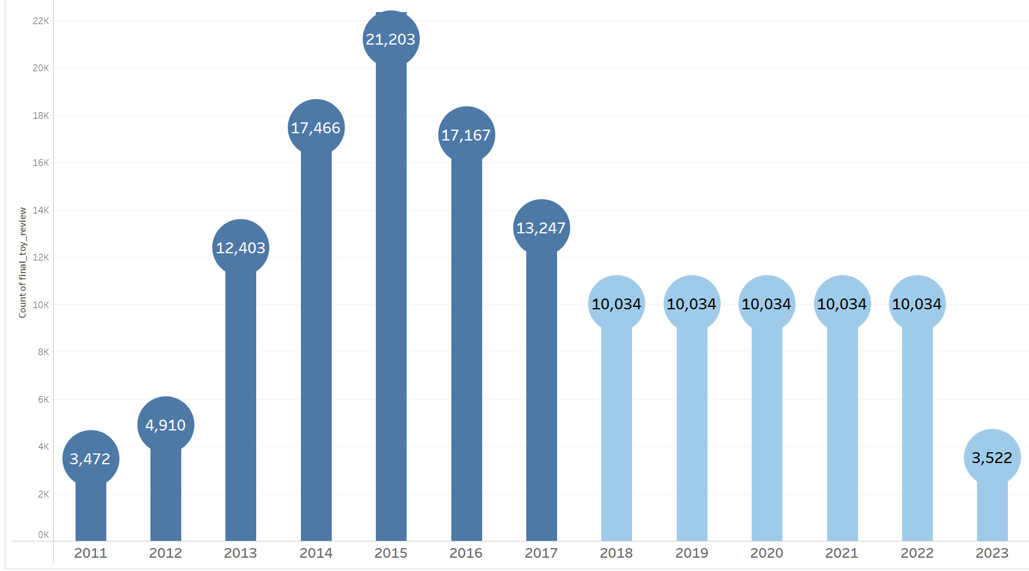
Forecast of Sales over years(Toy & Games)
OBSERVATION :
The Forecast of sales is decreasing after 2017,constant sales is recorded from 2018 to 2022 and there is huge sales dip in year 2023
SOLUTION :
we can improve our product quaality and advertising more about the uniqueness in our product

Slide 12
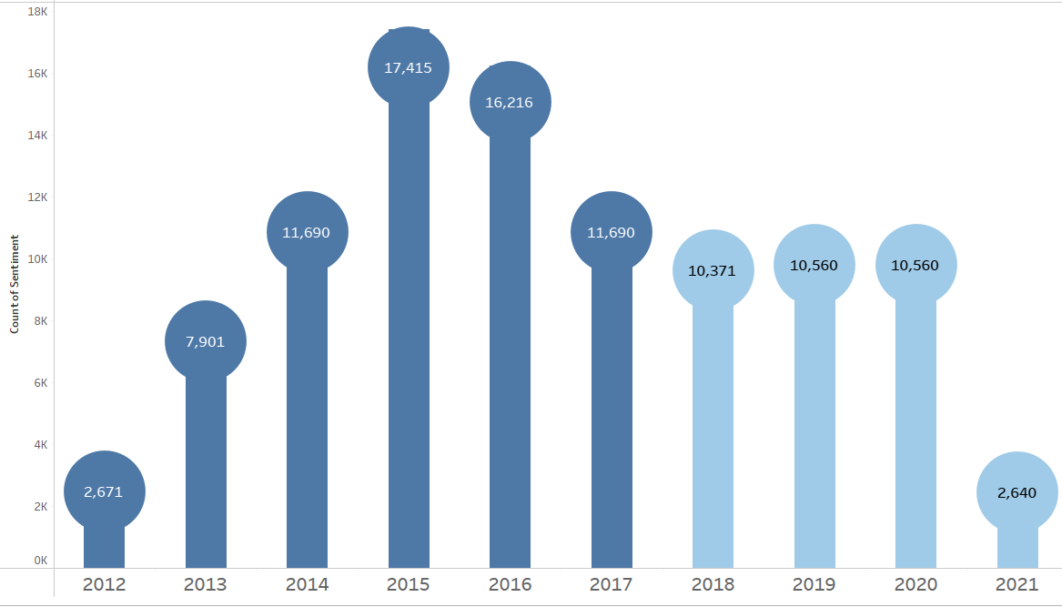
Forecast of Sales over years(Office Supplies Data)
OBSERVATION :
In 2015 the sales was the highest and in 2021 it is lowest.
the sales started declining after 2015.
SOLUTION :
we need to give more offers and have frequent sales so that more no. of customers are attracted towards us.

Slide 13
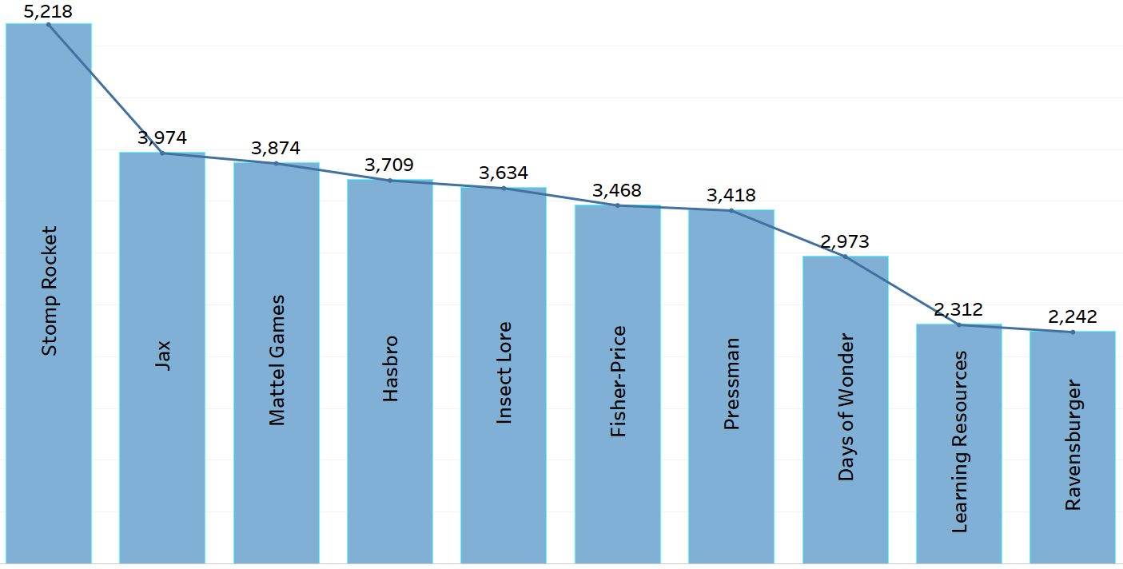
Brands having high sales as well as positive response(Toys & Games)
OBSERVATION :
From our Observations Stomp rock brand has both positive response as well as high sales
SOLUTION :
Continuously monitor ,analyze our sales and regularly evaluate and adjust our strategies based on feedback and results to ensure sustained growth.

Slide 14
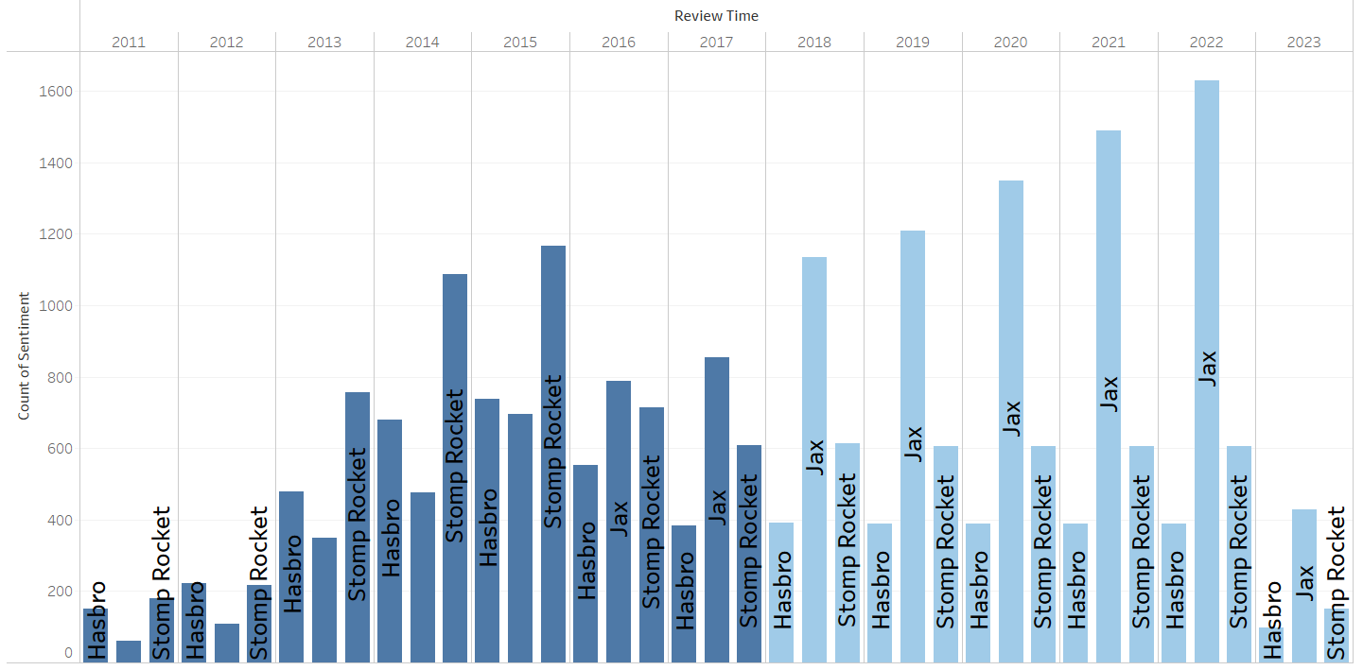
Forecast of Brands with Positive response(Toys & Games)
OBSERVATION :
From our Observations Jax brand has positive response
over years but in 2023 there is huge dip
SOLUTION :
To resolve this we need address the responses constantly
and improve our product quality and price over years

Slide 15
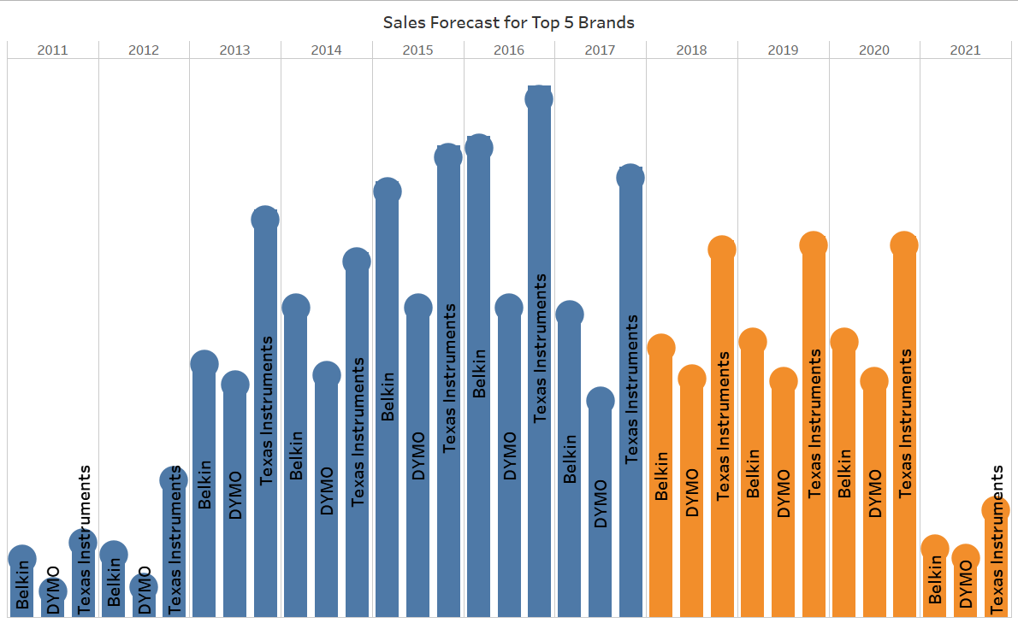
Forecast of Sales for the Top 3 Companies(Office Supplies)
Observations:-
It can be seen that brands such as Texas Instruments , Belkin are leading the chart.
A constant drop in overall sales can be seen after 2016 which is leading to a huge drop in 2021.
Solution:-
Customers issues should be resolved on priority.
Manufacturers and suppliers should be given strict guidelines regarding packing and manufacturing of the products.

Slide 16
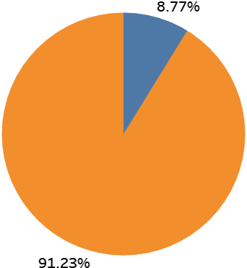
Percentage of Verified Customers (Office Supplies)
Observation:-
Verified customers constitute to about 91.23% of the total reviews whereas about 8.77% of total reviews are from unverified customers.
Suggestion:-
Since, not allowing un-verified customers to review could lead to loss of potiential regular customers the only step which we can take to keep the analysis fair is to not consider the reviews which are from unverified ids

Slide 17
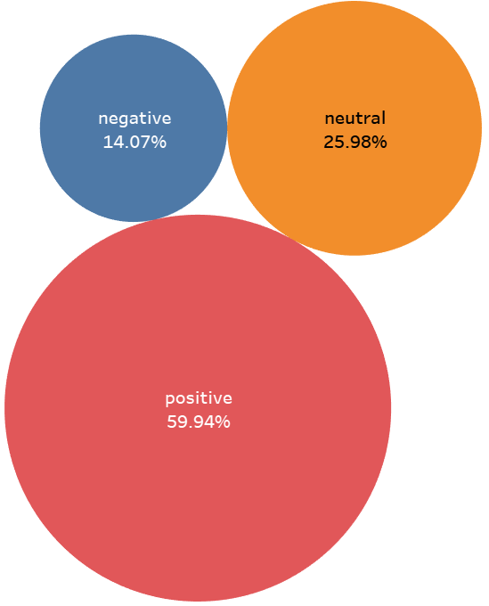
Percentage of Reviews given for each Sentiment (Office Supplies)
Observation:-
The positive reviews constitute to about 59.94%, the neutral reviews constitute to about 25.98% and the negative reviews constitute to about 14.07%.
Suggestion:
About 14.07% customers are prone to immediate attrition so they must be contacted and assured that the problems which they faced will not be repeated and some special offers/coupons should be provided to them as apology.

Slide 18
Technical Information
Tool | Purpose | Mode of Operation
TextBlob | Sentiment analysis | TextBlob gives a polarity value to the text according to the use of words and based on this polarity value it divides the text into positive , negative and neutral.
ARMA and SARIMA | Time-Series Forecasting | These models were selected depending on whether the text is stationary or non-stationary and seasonality. Toys RMSE :(0.04 and 0.02) Office RMSE:(0.11 AND 0.03)
sweet-viz, Pandas-Profiling | Auto-EDA | Performs EDA with the help of AI, give various visuals for better understanding.
WordCloud | Visualization | Provides a visual representation of a text, in which the words appear bigger the more often they are mentioned.
For Sentiment Analysis:
we have used TEXTBLOB library for sentiment analysis, This will help us understand how customers feel about the product.
For Time Series Forecasting:
we have used two models for forecasting
Auto Regressive Moving Average(ARMA)
Seasonality Auto Regressive Integrated Moving Average (SARIMA)
For Auto-EDA:
we used two libraries for Auto-Eda
sweet-viz and Pandas-Profiling for Auto-EDA.
These libraries created various useful visuals and tables which explains the data really well.

Slide 19
Suggested Solutions
Create a backend team to check the accountability of the reviews and credibility of the accounts.
The review of unverified customers shouldn’t be posted on our website and shouldn’t be considered for any kind of analysis as well.
Acknowledge the problem and rectify it with the help of negative responses.
After ordering any product a digital survey must be taken from each customer about the shopping experience and the product.
Manufacturers and suppliers should be given guidelines to follow a particular pattern of quality check before packing the products.
Need to improve our Marketing and advertising effectiveness.
Evaluate and adjust our strategies based on feedback and results to ensure sustained growth.

Slide 20


